Slide 1
ATM STIMULATOR

Slide 2
CONTENTS
INTRODUCTION
OBJECTIVE
FEATURES
MAIN COMPONENTS
FUNCTIONALITY OVERVIEW
SECURITY
TESTING AND VALIDATION
FUTURE ENHANCEMENTS
CONCLUSION

Slide 3
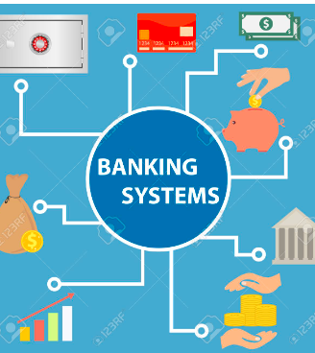
INTRODUCTION
This presentation introduces you to the ATM Stimulator for a banking system. Our ATM simulator aims to provide a realistic and interactive experience for users to perform common banking transactions conveniently.
Without further ado, let's dive into the world of our ATM simulator and explore the possibilities it offers. Let's get started!

Slide 4
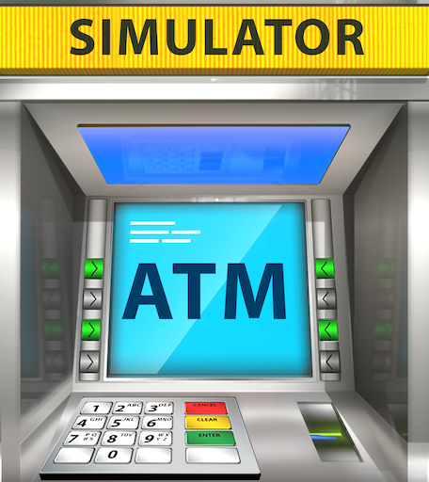
OBJECTIVE
Offering users a safe and realistic environment to hone their ATM transaction abilities is the main goal of the ATM Stimulator. The simulator, which is an essential tool for training and testing, attempts to close the gap between academic understanding and real-world application in the financial services industry.

Slide 5
FEATURES
To promote a realistic grasp of these procedures, users might mimic routine banking operations like cash withdrawals, deposit and account balance inquiries. The feature that generates automated receipts guarantees a definitive record of simulated transactions, providing a comprehensive and genuine banking experience.

Slide 6

MAIN COMPONENTS
ATM Class: Contains the main method and user interface.
UserAccounts Map: Stores user account numbers and balances.

Slide 7
Functionality Overview
Check Balance: Input: Account number. Output: Current account balance.
Deposit: Inputs: Account number, deposit amount. Action: Adds the deposit amount to the account balance.
Withdraw: Inputs: Account number, withdrawal amount. Action: Deducts the withdrawal amount from the account balance.
Exit: Terminates the ATM simulator program.

Slide 8

SECURITY
PIN Validation: Not implemented in this version but can be added for enhanced security.
Account Number Verification: Ensures that only valid account numbers are accepted.
Transaction Logging: Tracks all transactions for auditing purposes.

Slide 9
TESTING AND VALIDATION
Invalid Input: Displays error messages for incorrect input formats.
Insufficient Funds: Alerts users when attempting to withdraw more than their account balance.
Invalid Account Number: Notifies users when entering an unrecognized account number.
Unit Testing: Validates the functionality of individual methods.
Integration Testing: Verifies the interaction between different components.
User Acceptance Testing: Involves real users to ensure usability and reliability.

Slide 10
FUTURE ENHANCEMENTS
PIN-Based Authentication: Implement PIN validation for user authentication.
Graphical User Interface (GUI): Develop a GUI for a more intuitive user experience.
Database Integration: Store user account data in a database for scalability and persistence.

Slide 11
CONCLUSION
In conclusion, our ATM simulator serves as a practical and user-friendly solution for simulating banking transactions in a virtual environment.
Users can easily interact with the program to perform common banking tasks, making it an ideal tool for educational purposes, software testing, and personal use.

Slide 12

Thank you

